Slide 1


NEXT GEN EMPLOYABILITY PROGRAM
CREATING A FUTURE-READY WORKFORCE
Student Name :
MUTHUKUMARAN E
Student ID :
College Name :
STU65b8f32f89f4f1706619695
PERIYAR UNIVERSITY, SALEM

Slide 2
CAPSTONE PROJECT SHOWCASE
Project Title
CUSTOMER SEGMENTATION MODELS USING PYTHON
Abstract | Problem Statement | Project Overview | Proposed Solution | Technology Used | Modelling & Results | Conclusion | Q&A

Slide 3
Abstract
1
Data Cleaning & Transformation: We aim to prepare transactional data for customer segmentation by handling missing values, duplicates, and outliers. This step ensures the dataset's quality and reliability for subsequent analysis.
2
Feature Engineering for Customer-Centricity: By creating new features derived from transactional data, we will construct a customer-centric dataset. This approach will enable us to understand customer behavior better and lay the groundwork for effective segmentation strategies.
3
Data Preprocessing for Efficient Clustering: Through feature scaling and dimensionality reduction techniques, we will streamline the data, enhancing the clustering process's efficiency. This step is crucial for improving the accuracy and performance of our segmentation model.
4
Customer Segmentation using K-Means Clustering: Utilizing K-means clustering, we will segment customers into distinct groups based on their transactional behavior. This segmentation will empower businesses with valuable insights for targeted marketing, personalized strategies, and enhanced customer engagement.

Slide 4


Problem Statement
This project analyzes a transactional dataset from a UK retailer (2010-2011) to optimize marketing and increase sales through customer segmentation. Using K-means clustering, we aim to categorize customers into distinct groups based on transactional behavior, enabling tailored marketing strategies. By transforming transactional data into a customer-centric dataset, we seek to understand unique customer profiles and preferences. Building on segmentation, a recommendation system will suggest top-selling products to customers within each group, enhancing marketing effectiveness and driving sales growth. Through this approach, we aim to unlock insights into customer behavior, refining marketing strategies for sustained success in the online retail sector.

Slide 5

Project Overview
This project analyzes transactional data from a UK retailer (2010-2011) for marketing optimization and sales enhancement through customer segmentation. It includes data cleaning, feature engineering, and preprocessing for clustering. By utilizing K-means clustering, customers are segmented based on transactional behavior. This segmentation enables businesses to personalize marketing strategies and boost sales effectively. The project aims to refine marketing efforts and increase sales by leveraging insights from customer segmentation. Through meticulous data processing, the dataset is prepared for segmentation analysis. By understanding customer behavior patterns, tailored marketing initiatives can be deployed. Ultimately, this data-driven approach aims to drive sustained sales growth in the competitive online retail landscape.

Slide 6
Proposed Solution
Data Analysis and Preprocessing: Begin by thoroughly cleaning and preparing the transactional dataset, handling missing values, duplicates, and outliers.
Feature Engineering: Create new features derived from transactional data to construct a customer-centric dataset, capturing essential customer behavior patterns.
Dimensionality Reduction: Apply PCA (Principal Component Analysis) to reduce the dimensionality of the dataset while preserving its essential information.
Clustering Analysis: Utilize the K-means clustering algorithm to segment customers into distinct groups based on their transactional behavior.
Segment-Specific Recommendations: Develop a recommendation system that suggests top-selling products to customers within each segment, enhancing marketing effectiveness and driving sales growth.
Evaluation and Iteration: Evaluate the performance of the clustering and recommendation system using metrics such as silhouette score and customer engagement metrics. Iterate on the solution as needed to improve results.
Integration and Deployment: Integrate the solution into the retailer's marketing strategy and deploy it to enhance marketing campaigns and increase sales.

Slide 7
Technology used
Python Libraries: NumPy (as np), Pandas (as ), Seaborn (as sns), Matplotlib (as plt), GridSpecpd (Matplotlib), Plotly Graph Objects (as go), LinearSegmentedColormap (Matplotlib), Colors module (Matplotlib), Linregress (SciPy), IsolationForest (Scikit-learn), StandardScaler (Scikit-learn).
Data Analysis: Utilized for data preprocessing, outlier detection, and dimensionality reduction.
Visualization: Facilitated visualization of data patterns and clustering results.
Machine Learning: Implemented for clustering analysis using the K-means algorithm.
Evaluation: Used to assess clustering performance using metrics like silhouette score.
Data Presentation: Tabulate and Counter libraries employed for organized data presentation.

Slide 8
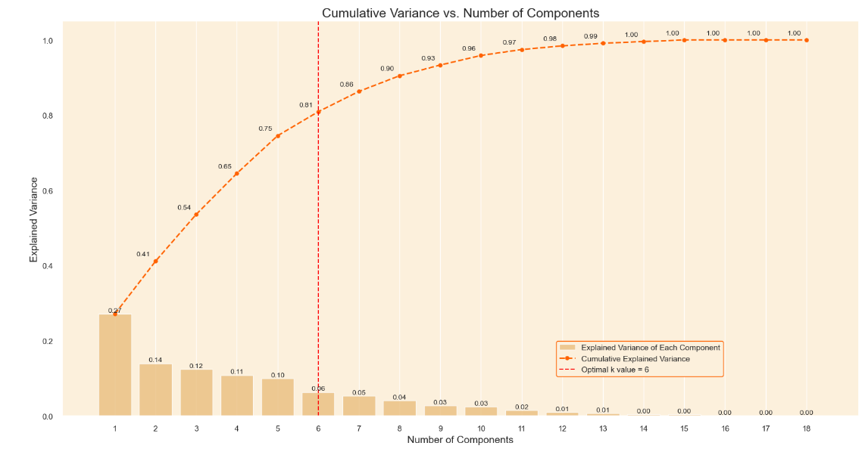
Modelling & Result
The cumulative explained variance plot indicates that the first 6 components capture approximately 81% of the total variance, making them a balanced choice for dimensionality reduction. This retention ensures sufficient information for effective customer segmentation while reducing dataset complexity.

Slide 9
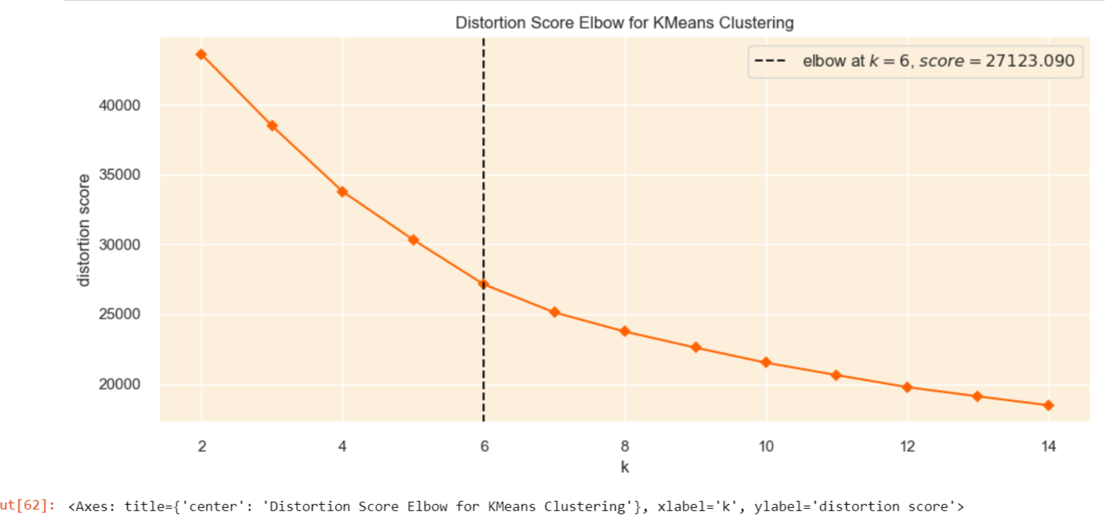
Modelling & Result
Optimal k Value: The Elbow Method suggests k=5 as the optimal value, although the plot lacks a clear elbow point, common in real-world data. Inertia decreases notably up to k=5, indicating the optimal k could range between 3 and 7. Silhouette analysis and business insights will further refine the selection process.

Slide 10
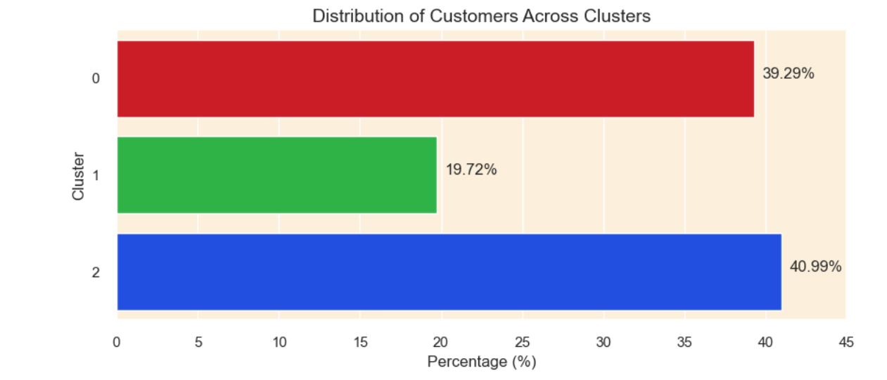
Modelling & Result
Cluster Distribution: The bar plot shows a balanced distribution, with clusters 0 and 1 each covering about 41% of customers, and cluster 2 holding around 18%. This balance suggests successful segmentation, not noise. Each cluster represents a distinct segment, aiding future strategies. No cluster has a negligible customer count, ensuring significance for nuanced analysis and informed decisions.

Slide 11
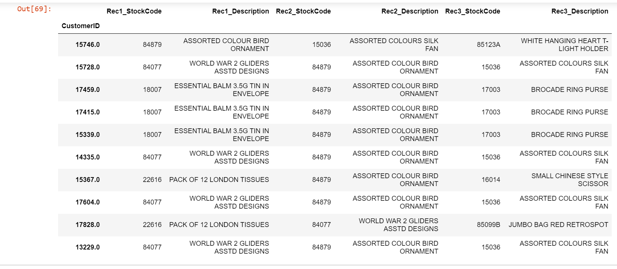
Modelling & Result
A recommendation system was developed to enhance online shopping, suggesting products based on customer cluster purchasing patterns. Outliers (5% of customers) were isolated, and the core 95% analyzed to identify top-selling products within each cluster. Personalized recommendations were crafted, suggesting the top three unpurchased products per cluster. This approach facilitates targeted marketing and enriches the shopping experience. Additionally, a basic recommendation approach for outliers could involve suggesting random products.

Slide 12

Conclusion
Our Python-driven customer segmentation project resulted in a sophisticated recommendation system, enhancing the online shopping experience. By meticulously analyzing data and deriving insights from customer clusters, we crafted personalized recommendations tailored to individual preferences and cluster trends. These recommendations promise to boost sales and customer satisfaction through targeted marketing strategies. Looking ahead, future iterations could incorporate real-time data streams for dynamic cluster updates and employ advanced machine learning techniques for more accurate predictions. This project also served as a valuable learning opportunity, enhancing our proficiency in data preprocessing, clustering algorithms, and recommendation systems.

Slide 13


Notes:
Thank You !!

